Slide 1

Parul University
Session: July-Dec. 2024
Slide No. 1

Slide 2
Parul University
203105374: Design & Analysis of Algorithm
Date
Slide No.

Slide 3
Prerequisites
Before proceeding the subject, you should have a basic understanding of C programming language, text editor, and execution of programs, etc.
Slide No.

Slide 4
Course Objectives
To understand the basic idea of the problem and find an approach to solve the problem.
Analyse and improve the efficiency of existing techniques.
To understand the basic principles of designing the algorithms compare the performance of the algorithm with respect to other techniques.
It is the best method of description without describing the implementation detail.
The Algorithm gives a clear description of requirements and goal of the problem to the designer. A good de.sign can produce a good solution.
Slide No.

Slide 5
Text Books
1. Thomas H. Coreman, Charles E. Leiserson and Ronald L. Rivest, “Introduction to Algorithms”, Printice Hall of India.
2. E. Horowitz & S Sahni, "Fundamentals of Computer Algorithms",
3. Aho, Hopcraft, Ullman, “The Design and Analysis of Computer Algorithms” Pearson Education, 2008.
Slide No.

Slide 6
Reference Books
Aho, Hopcroft, Ullman, “Data Structures and Algorithms”, Pearson Education.
N. Wirth, “Algorithms + Data Structure = Programs”, Prentice Hall.
Jean – Paul Trembly , Paul Sorenson, “An Introduction to Structure with application”, TMH.
Richard, GilbergBehrouz, Forouzan ,“Data structure – A Pseudocode Approach with C”, Thomson press
Slide No.

Slide 7
Unit-1 Introduction
Introduction: Algorithms
Analyzing algorithms
Complexity of algorithms
Growth of functions
Performance measurements Sorting and order Statistics
Shell sort
Quick sort
Merge sort
Heap sort
Comparison of sorting algorithm
Slide No.

Slide 8
What is an Algorithm?
The word Algorithm means ”A set of finite rules or instructions to be followed in calculations or other problem-solving operations”
Or
A procedure for solving a mathematical problem in a finite number of steps that frequently involves recursive operations.
Ex. An algorithm to add two numbers:
Take two number inputs
Add numbers using the + operator
Display the result
Slide No.

Slide 9
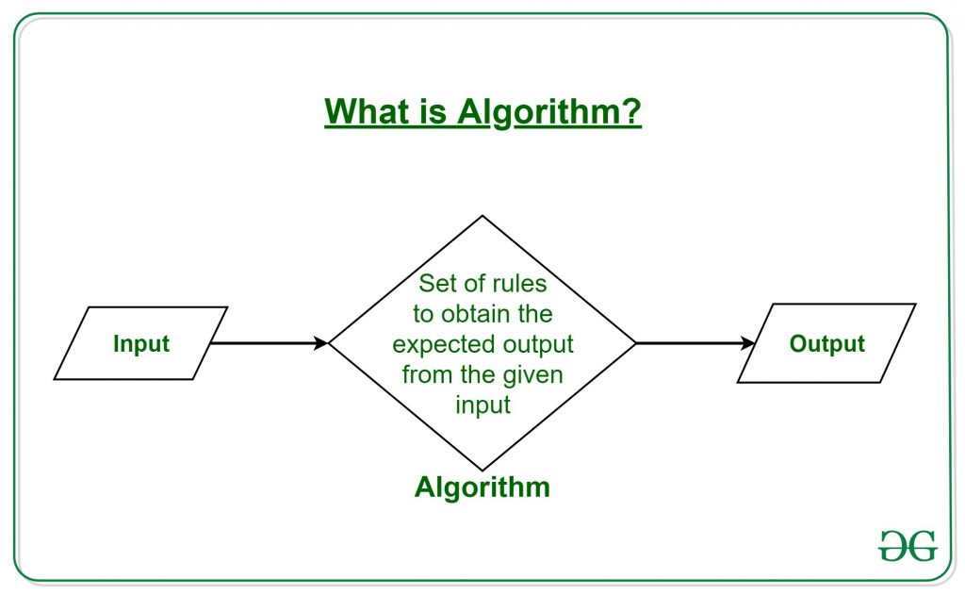
Slide No.

Slide 10
Use of the Algorithms:-
Computer Science: simple sorting and searching to complex tasks
Mathematics: optimal solution to a system of linear equations or finding the shortest path in a graph.
Operations Research: Transportation, logistics, and resource allocation.
Artificial Intelligence: image recognition, natural language processing, and decision-making.
Data Science: Extract insights from large amounts of data in fields such as marketing, finance, and healthcare.
Slide No.
Notes:
Computer Science: Algorithms form the basis of computer programming and are used to solve problems ranging from simple sorting and searching to complex tasks such as artificial intelligence and machine learning.
Mathematics: Algorithms are used to solve mathematical problems, such as finding the optimal solution to a system of linear equations or finding the shortest path in a graph.
Operations Research: Algorithms are used to optimize and make decisions in fields such as transportation, logistics, and resource allocation.
Artificial Intelligence: Algorithms are the foundation of artificial intelligence and machine learning, and are used to develop intelligent systems that can perform tasks such as image recognition, natural language processing, and decision-making.
Data Science: Algorithms are used to analyze, process, and extract insights from large amounts of data in fields such as marketing, finance, and healthcare.

Slide 11
What is the need for algorithms:
Algorithms are necessary for solving complex problems efficiently and effectively.
They help to automate processes and make them more reliable, faster, and easier to perform.
Algorithms also enable computers to perform tasks that would be difficult or impossible for humans to do manually.
They are used in various fields such as mathematics, computer science, engineering, finance, and many others to optimize processes, analyze data, make predictions, and provide solutions to problems.
Slide No.

Slide 12
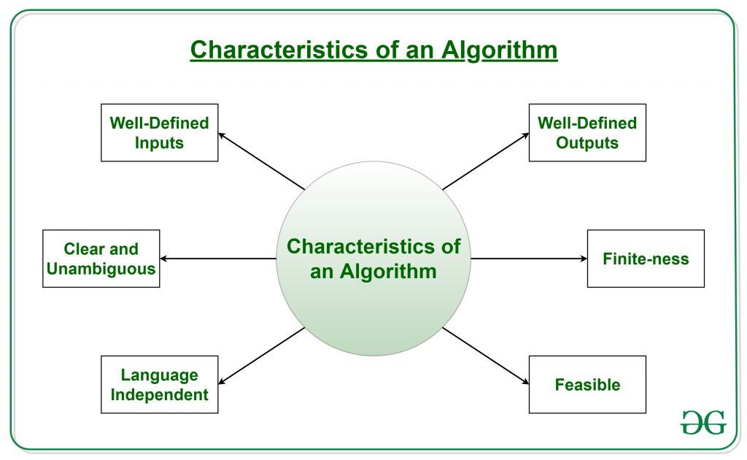
What are the Characteristics of an Algorithm?
Slide No.

Slide 13
Properties of Algorithm:
It should terminate after a finite time.
It should produce at least one output.
It should take zero or more input.
It should be deterministic means giving the same output for the same input case.
Every step in the algorithm must be effective i.e. every step should do some work.
Slide No.

Slide 14
Types of Algorithms:
Brute Force Algorithm
Recursive Algorithm
Backtracking Algorithm
Searching Algorithm
Sorting Algorithm
Hashing Algorithm
Divide and Conquer Algorithm
Greedy Algorithm
Dynamic Programming Algorithm
Randomized Algorithm:
Slide No.

Slide 15
Algorithm 1: Add two numbers entered by the user
Step 1: Start
Step 2: Declare variables num1, num2 and sum.
Step 3: Read values num1 and num2.
Step 4: Add num1 and num2 and assign the result to sum. sum←num1+num2
Step 5: Display sum
Step 6: Stop
Slide No.

Slide 16
Python program to add two numbers
def addNum(a, b): return a+b a = int(input("Enter number one ")) b = int(input("Enter number two ")) print(addNum(a,b))

Slide 17
Algorithm 2: Find the largest number among three numbers
Step 1: Start
Step 2: Declare variables a,b and c.
Step 3: Read variables a,b and c.
Step 4: If a > b
If a > c
Display a is the largest number.
Else
Display c is the largest number.
Else
If b > c
Display b is the largest number.
Else
Display c is the greatest number.
Step 5: Stop
Slide No.

Slide 18
Python program to find largest number among three numbers
def maximum(a, b, c): if (a>=b) and (a>=c): largest = a elif(b>=a) and (b>=c): largest = b else: largest = c return largest a = int(input(" Enter number one ")) b = int(input(" Enter number two ")) c = int(input(" Enter number three")) print(maximum(a,b,c))

Slide 19
Analyzing algorithms
Analysis of algorithms is the determination of the amount of time and space resources required to execute it.
Usually, the efficiency or running time of an algorithm is stated as a function relating the input length to the number of steps, known as time complexity, or volume of memory, known as space complexity.
Analysis of algorithms is the determination of the amount of time and space resources required to execute it.
Slide No.

Slide 20
The Need for Analysis
Algorithms are often quite different from one another, though the objective of these algorithms are the same.
For example, we know that a set of numbers can be sorted using different algorithms.
Number of comparisons performed by one algorithm may vary with others for the same input.
Hence, time complexity of those algorithms may differ. At the same time, we need to calculate the memory space required by each algorithm.
Slide No.

Slide 21
How to analyze an Algorithm?
Priori Analysis: Priori” means “before”. Hence Priori analysis means checking the algorithm before its implementation. In this, the algorithm is checked when it is written in the form of theoretical steps. This Efficiency of an algorithm is measured by assuming that all other factors, for example, processor speed, are constant and have no effect on the implementation. It gives the approximate answers for the complexity of the program.
Posterior Analysis:“Posterior” means “after”. Hence Posterior analysis means checking the algorithm after its implementation. In this, the algorithm is checked by implementing it in any programming language and executing it. This analysis helps to get the actual and real analysis report about correctness(for every possible input/s if it shows/returns correct output or not), space required, time consumed etc. That is, it is dependent on the language of the compiler and the type of hardware used.
Slide No.

Slide 22
Complexity of Algorithms
An algorithm is defined as complex based on the amount of Space and Time it consumes.
The Complexity of an algorithm refers to the measure of the Time that it will need to execute and get the expected output, and the Space it will need to store all the data (input, temporary data and output).
Hence these two factors define the efficiency of an algorithm.
Time Factor: Time is measured by counting the number of key operations such as comparisons in the sorting algorithm.
Space Factor: Space is measured by counting the maximum memory space required by the algorithm to run/execute.
Slide No.

Slide 23
Complexity of an algorithm can be divided into two types:
Time Complexity: The time complexity of an algorithm refers to the amount of time that is required by the algorithm to execute and get the result. This can be for normal operations, conditional if-else statements, loop statements, etc.
Space Complexity: The space complexity of an algorithm refers to the amount of memory required by the algorithm to store the variables and get the result. This can be for inputs, temporary operations, or outputs.
Slide No.

Slide 24
How to calculate Time Complexity?
The time complexity of an algorithm is also calculated by determining the following 2 components:
Constant time part: Any instruction that is executed just once comes in this part. For example, input, output, if-else, switch, arithmetic operations etc.
Variable Time Part: Any instruction that is executed more than once, say n times, comes in this part. For example, loops, recursion, etc.
Therefore Time complexity of any algorithm P is T(P) = C + TP(I), where C is the constant time part and TP(I) is the variable part of the algorithm, which depends on the instance characteristic I.
Slide No.

Slide 25
Calculating Time Complexity
Example: Consider the below algorithm for Linear Search
Step 1: START Step 2: Get n elements of the array in arr and the number to be searched in x Step 3: Start from the leftmost element of arr[] and one by one compare x with each element of arr[] Step 4: If x matches with an element, Print True. Step 5: If x doesn’t match with any of the elements, Print False. Step 6: END
Example: In the algorithm of Linear Search above, the time complexity is calculated as follows:
Step 1: –Constant Time 1 Step 2: — Constant Time (Taking x input). 1 Step 3: –Variable Time (Till the length of the Array (n) or the index of the found element) n Step 4: –Constant Time 1 Step 5: –Constant Time 1 Step 6: –Constant Time 1 Hence, T(P) = 5 + n, which can be said as T(n).
Slide No.

Slide 26
How to calculate Space Complexity?
The space complexity of an algorithm is calculated by determining the following 2 components:
Fixed Part: This refers to the space that is definitely required by the algorithm. For example, input variables, output variables, program size, etc.
Variable Part: This refers to the space that can be different based on the implementation of the algorithm. For example, temporary variables, dynamic memory allocation, recursion stack space, etc. Therefore Space complexity S(P) of any algorithm P is S(P) = C + SP(I), where C is the fixed part and S(I) is the variable part of the algorithm, which depends on instance characteristic I.
Here, There are 2 variables arr[], and x, where the arr[] is the variable part of n elements and x is the fixed part. Hence S(P) = 1+n. So, the space complexity depends on n(number of elements). Now, space depends on data types of given variables and constant types and it will be multiplied accordingly.
Slide No.

Slide 27
How to express an Algorithm?
Natural Language :- Here we express the Algorithm in natural English language. It is too hard to understand the algorithm from it.
Flow Chat :- Here we express the Algorithm by making graphical/pictorial representation of it. It is easier to understand than Natural Language.
Pseudo Code :- Here we express the Algorithm in the form of annotations and informative text written in plain English which is very much similar to the real code but as it has no syntax like any of the programming language, it can’t be compiled or interpreted by the computer. It is the best way to express an algorithm because it can be understood by even a layman with some school level programming knowledge.
Slide No.

Slide 28
Cases of Analysis
Worst-case − Define the input for which algorithm takes a long time or maximum time. In the worst calculate the upper bound of an algorithm. Example: In the linear search when search data is not present at all then the worst case occurs.
Best-case − Define the input for which algorithm takes less time or minimum time. In the best case calculate the lower bound of an algorithm. Example: In the linear search when search data is present at the first location of large data then the best case occurs
Average case − In the average case take all random inputs and calculate the computation time for all inputs. And then we divide it by the total number of inputs.
Average case = all random case time / total no of case
Slide No.

Slide 29
Asymptotic Analysis of algorithms (Growth of function)
Asymptotic notations are used to write fastest and slowest possible running time for an algorithm. These are also referred to as 'best case' and 'worst case' scenarios respectively.
"In asymptotic notations, we derive the complexity concerning the size of the input. (Example in terms of n)"
"These notations are important because without expanding the cost of running the algorithm, we can estimate the complexity of the algorithms.“
Asymptotic Notation is a way of comparing function that ignores constant factors and small input sizes.
Let f (n) = an²+bn+c
Slide No.

Slide 30
Types of asymptotic notations
There are mainly three asymptotic notations:
Big-O notation
Omega notation
Theta notation
Slide No.

Slide 31
Big-O Notation (O-notation)
Big-O notation represents the upper bound of the running time of an algorithm. Thus, it gives the worst-case complexity of an algorithm.
O(g(n)) = { f(n): there exist positive constants c and n₀ such that 0 ≤ f(n) ≤ cg(n) for all n ≥ n₀ }
The above expression can be described as a function f(n) belongs to the set O(g(n)) if there exists a positive constant c such that it lies between 0 and cg(n), for sufficiently large n.
For any value of n, the running time of an algorithm does not cross the time provided by O(g(n)).
Slide No.

Slide 32
Omega Notation (Ω-notation)
Omega notation represents the lower bound of the running time of an algorithm. Thus, it provides the best case complexity of an algorithm.
Ω(g(n)) = { f(n): there exist positive constants c and n₀ such that 0 ≤ cg(n) ≤ f(n) for all n ≥ n₀ }
The above expression can be described as a function f(n) belongs to the set Ω(g(n)) if there exists a positive constant c such that it lies above cg(n), for sufficiently large n.
For any value of n, the minimum time required by the algorithm is given by Omega Ω(g(n)).
Slide No.

Slide 33
Theta Notation (Θ-notation)
Theta notation encloses the function from above and below. Since it represents the upper and the lower bound of the running time of an algorithm, it is used for analyzing the average-case complexity of an algorithm.
For a function g(n), Θ(g(n)) is given by the relation:
Θ(g(n)) = { f(n): there exist positive constants c₁, c₂ and n₀ such that 0 ≤ c₁g(n) ≤ f(n) ≤ c₂g(n) for all n ≥ n₀ }\
The above expression can be described as a function f(n) belongs to the set Θ(g(n)) if there exist positive constants c₁ and c₂ such that it can be sandwiched between c₁g(n) and c₂g(n), for sufficiently large n.
If a function f(n) lies anywhere in between c₁g(n) and c₂g(n) for all n ≥ n0, then f(n) is said to be asymptotically tight bound.
Slide No.

Slide 34
O(1)constant time
This means that the algorithm requires the same fixed number of steps regardless of the size of the task.
Example:
1) A statement involving basic operations
Here are some examples of basic operations.
One arithmetic operation (eg., +, *)
One assignment(x=5)
One test (eg., x==0)
One read(accessing an element from an array)
Slide No.

Slide 35
Example of O(1) Constant time Complexity
public static int sumN(int n){
int ans = n*(n+1)/2;
return ans;
}

Slide 36
CONT…
2) Sequence of statements involving basic operations.
statement 1;
statement 2;
..........
statement k;
Time for each statement is constant and the total time is also constant: O(1)
Slide No.

Slide 37
O(n)linear time
This means that the algorithm requires a number of steps proportional to the size of the task.
Examples:
1. Traversing an array.
2. Sequential/Linear search in an array.
3. Best case time complexity of Bubble sort (i.e when the elements of array are in sorted order).
Slide No.

Slide 38
CONT…
Basic structure is :
for (i = 0; i < N; i++)
{
sequence of statements of O(1)
}
The loop executes N times, so the total time is N*O(1) which is O(N).
Slide No.

Slide 39
Example of O(n) Time Complexity
public static int sumN(int n){
int count = 0;
for (int i = 1;i <= n;i++){
count+=i;
}
return count;
}
Initialization: int count = 0;
– This is a constant time operation, O(1) .
Loop: for (int i = 1; i <= n; i++) – This loop runs from i = 1 to i = n. Therefore, it runs n times, contributing O(n) to the time complexity.
Increment inside loop: count += i;
– This operation is performed n times, once for each iteration of the loop. Each iteration is a constant time operation, O(1).
I = 1 || count = 1
I = 2 || count = 1+2
I = 3 || count = 1+2+3
I = 4 || count = 1+2+3+4
I = 5 || count = 1+2+3+4+5
O(1) + O(n) + O(1) = O(n)
Total Count = 15
n = 5

Slide 40
O(N²) quadratic time
The number of operations is proportional to the size of the task squared.
Examples:
1) Worst case time complexity of Bubble, Selection and Insertion sort.
Nested loops:
for (i = 0; i < N; i++) {
for (j = 0; j < M; j++) {
sequence of statements of O(1)
}
}
Slide No.

Slide 41
CONT...
The outer loop executes N times and inner loop executes M times so the time complexity is O(N*M)
2). for (i = 0; i < N; i++) {
for (j = 0; j < N; j++) {
sequence of statements of O(1)
}
}
Now the time complexity is O(N^2)
Slide No.

Slide 42
Time Complexity of bubble sort algorithm
public static void bubbleSort(int[] arr) {
int n = arr.length;
for (int i = 0; i < n - 1; i++) {
for (int j = 0; j < n - 1 - i; j++) {
if (arr[j] > arr[j + 1]) {
// Swap arr[j] and arr[j + 1]
int temp = arr[j];
arr[j] = arr[j + 1];
arr[j + 1] = temp;
}
}
}
}
Outer Loop: `for (int i = 0; i < n - 1; i++)`
This loop runs n−1 times. In Big-O notation, we consider the highest-order term, so this contributes O(n).
Inner Loop: `for (int j = 0; j < n - 1 - i; j++)`
For each iteration of the outer loop, the inner loop runs n−1−i times.
On the first iteration of the outer loop, the inner loop runs n−1 times
On the second iteration, it runs n−2 times.
This continues until the last iteration where it runs 1 time.

Slide 43
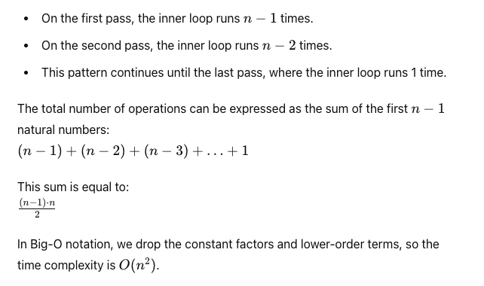
Summing Up the Operations
½ * n² – ½ * n²

Slide 44
CONT…
3. let's consider nested loops where the number of iterations of the inner loop depends on the value of the outer loop's index.
for (i = 0; i < N; i++) {
for (j = i+1; j < N; j++) {
sequence of statements of O(1)
}
}
Slide No.

Slide 45
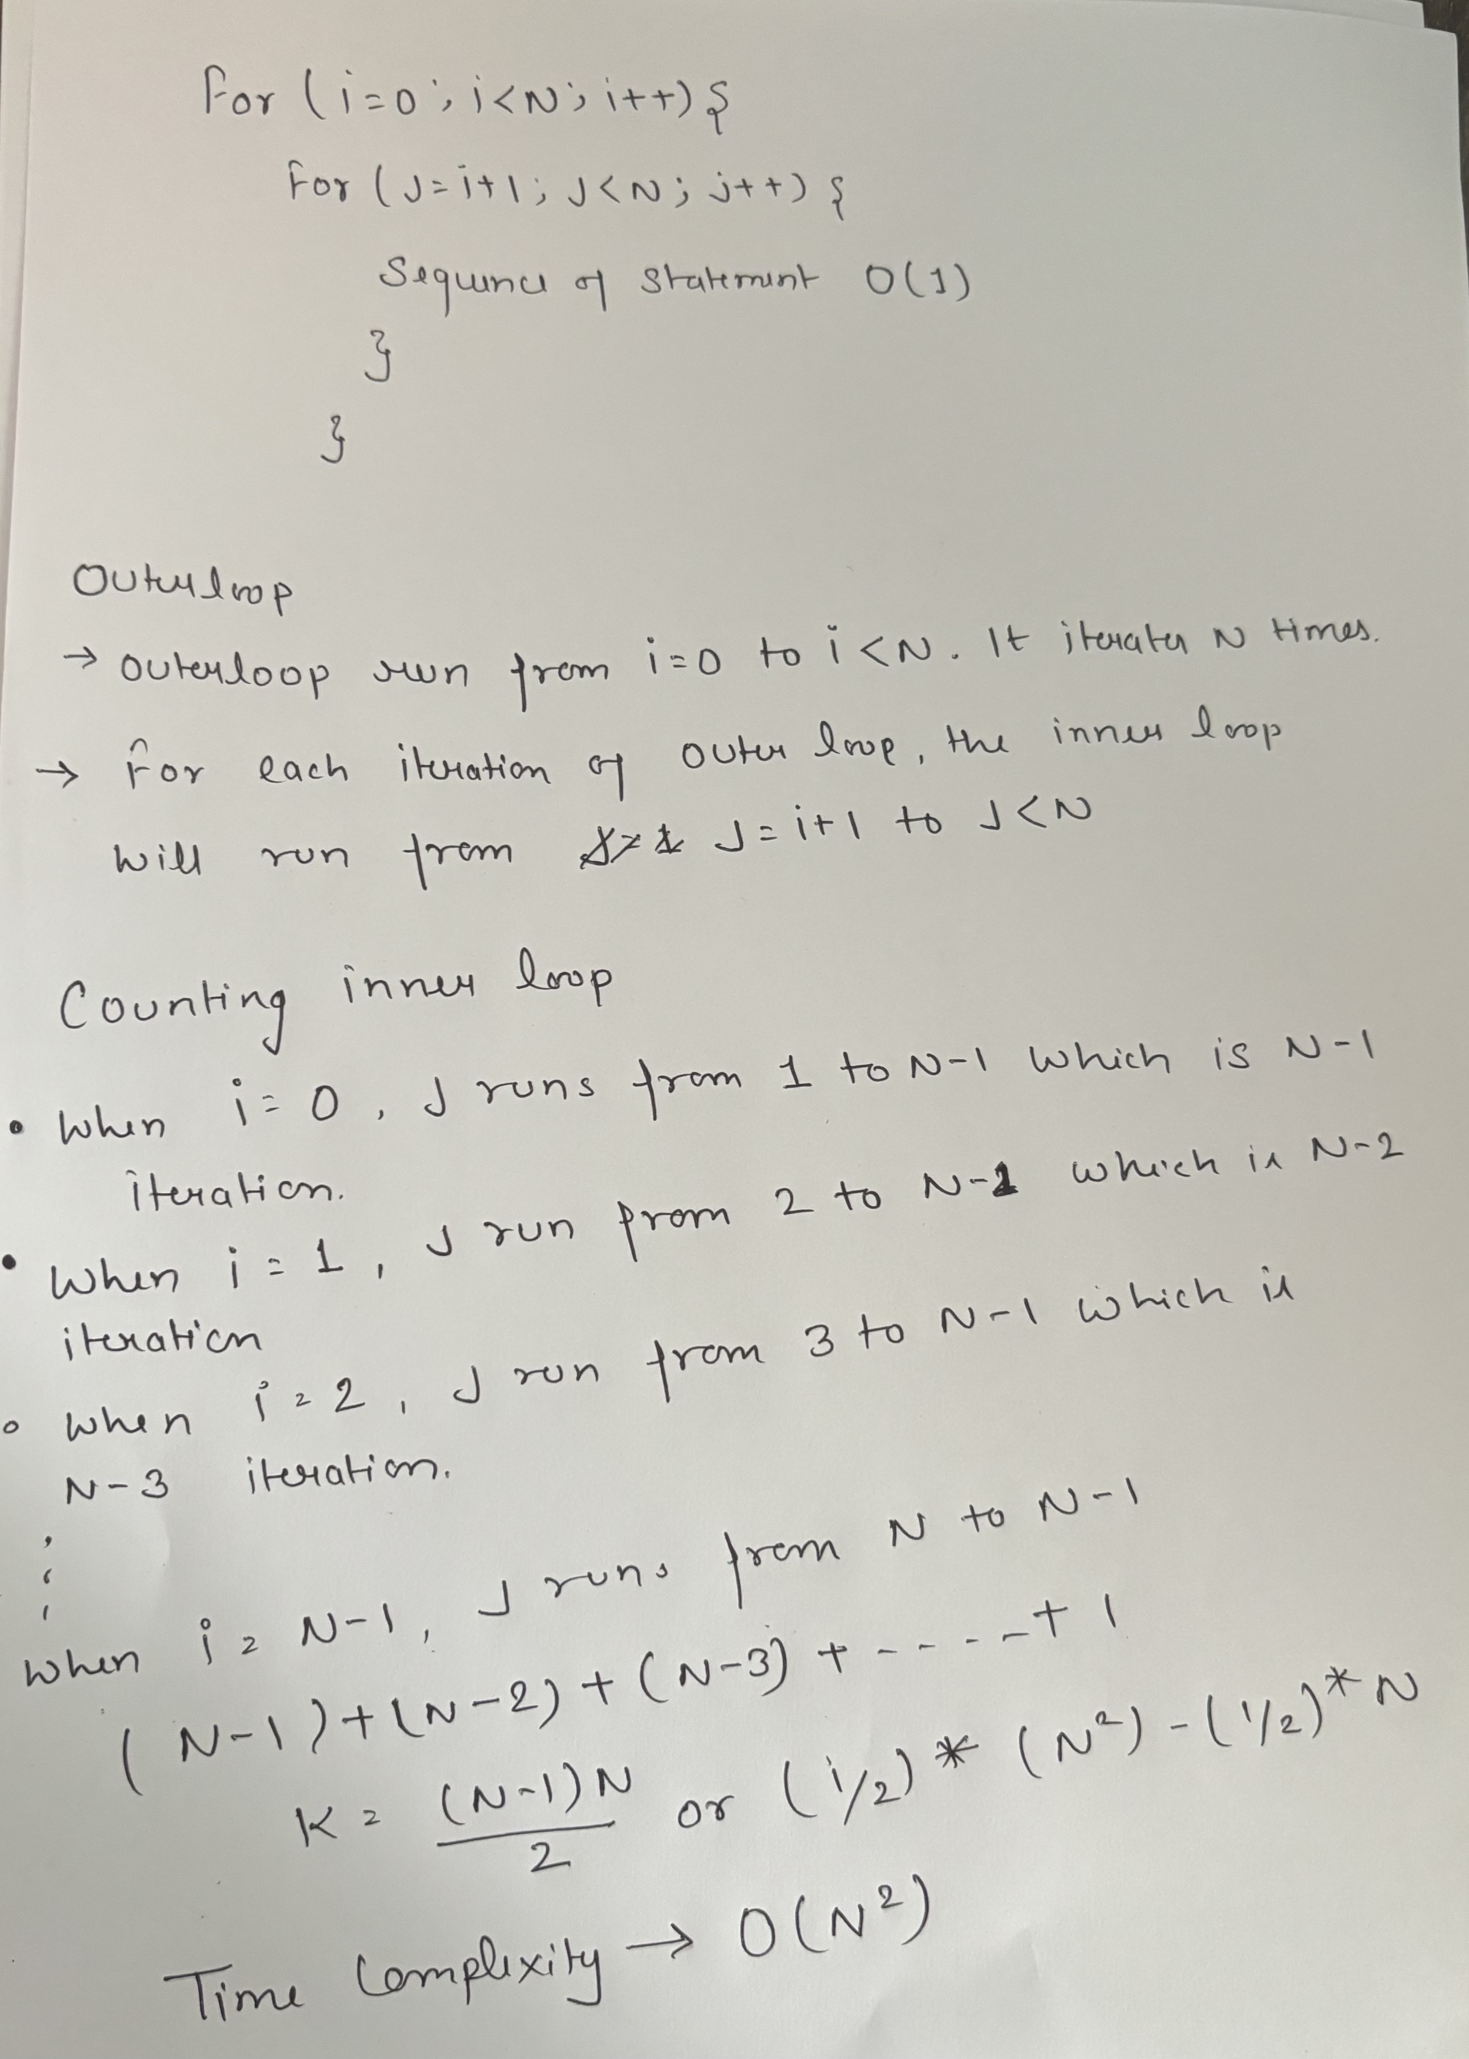

Slide 46
CONT…
Let us see how many iterations the inner loop has:
Value of i Number of iterations of inner loop
0 N-1
1 N-2
..... .......
N-3 2
N-2 1
N-1 0
Slide No.

Slide 47
CONT…
So the total number of times the “sequence of statements” within the two loops executes is :
(N-1)+(N-2)+.....2+1+0
which is N*(N-1)/2
or
(1/2)* (N²)-(1/2)* N
and we can say that it is O(N²) (we can ignore multiplicative constant and for large problem size the dominant term determines the time complexity)
Slide No.

Slide 48
O(log n) logarithmic time
Examples:
1. Binary search in a sorted array of n elements.
O(n log n)- "n log n " time
Examples:
1. MergeSort, QuickSort etc.
Slide No.

Slide 49
Time complexity for traversing the array and multiply the increment pointer by 2
public static int countSum(int N){
int count = 0;
for(int i = 1; i < N; i*=2){
count++;
}
return count;
}

Slide 50
Time Complexity = O(k)
Iteration No.
i
Step 2 -> i < N
1
2
3
4
5
.
.
.
i = 1 -> 2⁰ -> 2¹⁻¹
i = 2 -> 2¹ -> 2²⁻¹
i = 4 -> 2² -> 2³⁻¹
i = 8 -> 2³ -> 2⁴⁻¹
i = 16 -> 2^{4 ->} 2⁵⁻¹
.
.
.
Step 3 -> 2^{k} < N
Step 4 -> log₂(2^{k}) < log₂(N)
Step 5 -> k log₂² < log₂^{N}
Step 6 -> value of log₂² => 1
Step 7 -> k*1 = k < log₂^{N}
Step 8 -> final expression => k < log₂^{N}
k^{th}
2^{k-1}
Time Complexity – O(log n)
(k+1)^{th}
2^{(k+1)-1} => 2^{k}

Slide 51
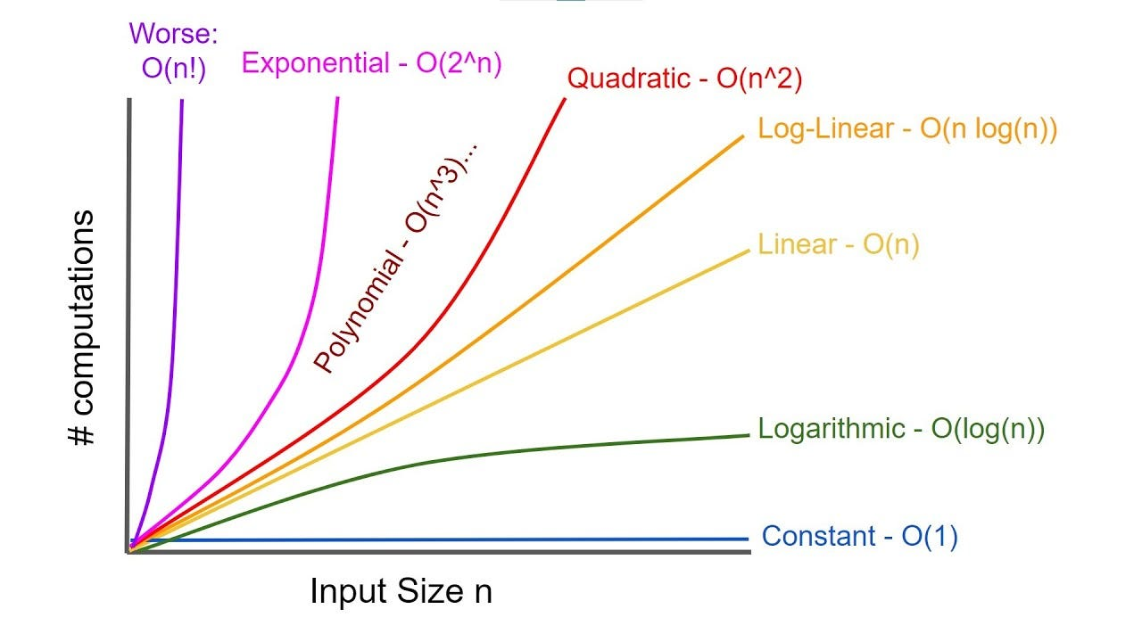
Using the "<" sign informally, we can say that the order of growth is-
O(l) < O(log n) < O(n) < O(n log n) < O(n^2) < O(n^3) < O(a^n)
where a>1
Slide No.

Slide 52
Example:
{perform any statement S1} O(1)
for (i=0; i < n; i++)
{
{perform any statement(s) S2} O(n)
{run through another loop n times} O(n²)
}
Total Execution Time: O(1) + O(n) +O(n²) therefore, O(n²)
Slide No.

Slide 53
Difference Between Upper Bound, Lower Bound and Tight Bound
Upper Bound
Lower Bound
Tight Bound
Worst-Case Analysis: Represents the maximum time an algorithm can take.
Notation: O(f(n)).
Growth Rate: Indicates the upper limit on the growth rate of the algorithm's time complexity.
Ensures No Exceeding: Ensures the algorithm won't take more than O(f(n)) time for large inputs.
Examples: Bubble Sort has an upper bound of O(n^2).
Best-Case Analysis: Represents the minimum time an algorithm can take.
Notation: Ω(f(n)).
Growth Rate: Indicates the lower limit on the growth rate of the algorithm's time complexity.
Guarantees Minimum Time: Ensures the algorithm will take at least Ω(f(n) time for large inputs.
Examples: Bubble Sort has a lower bound of Ω(n).
Exact Analysis: Represents the precise time an algorithm will take.
Notation: Θ(f(n)).
Growth Rate: Indicates the exact growth rate of the algorithm's time complexity.
Combines Both Bounds: Ensures the algorithm takes exactly Θ(f(n))time, covering both upper and lower bounds.
Examples: Merge Sort has a tight bound of Θ(nlogn)

Slide 54
Analyzing control statement
There are some algorithm control structures which are present in each programming code and have a specific asymptotic analysis.
Some Algorithm Control Structures are:
Sequencing
If - then – else
For loop
While loop

Slide 55
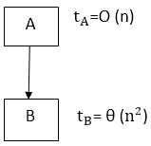
Sequencing
Suppose our algorithm consists of two parts A and B. A takes time t_{A} and B takes time t_{B} for computation. The total computation "t_{A} + t_{B}" is according to the sequence rule. According to maximum rule, this computation time is (max (t_{A},t_{B})).
Example:
Suppose t_{A} =O (n) and t_{B} = θ (n²). Then, the total computation time can be calculated as
Computation Time = t_{A} + t_{B} = (max (t_{A},t_{B}) = (max (O (n), θ (n²)) = θ (n²)
Note - Since Θ(n²) grows faster than O(n) as n increases, the Θ(n²) term will dominate. This is why the computation time is considered Θ(n²) and not O(n).
Θ(n²) = highest order of growth

Slide 56
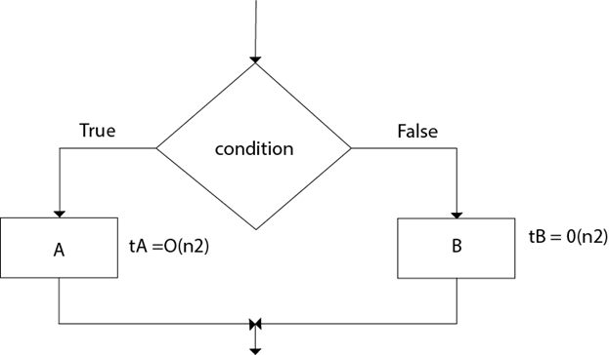
If-then-else
The total time computation is according to the condition rule-"if-then-else." According to the maximum rule, this computation time is max (t_{A},t_{B}).
Example:
Suppose t_{A} = O (n²) and t_{B} = θ (n²) Calculate the total computation time for the following:
Total Computation = (max (t_{A},t_{B})) = max (O (n²), θ (n²) = θ (n²)
Note - Since Θ(n²) is a tighter bound compared to O(n²), the maximum of these two would be Θ(n²). This is because Θ(n²) precisely characterizes the growth rate, whereas O(n²) only provides an upper limit.

Slide 57
For loop
The general format of for loop is: For (initialization; condition; updation) → Statement(s);
Complexity of for loop:
The outer loop executes N times. Every time the outer loop executes, the inner loop executes M times. As a result, the statements in the inner loop execute a total of N * M times. Thus, the total complexity for the two loops is O (N²)
Consider the following loop:
for i ← 1 to n
{
P (i)
}
If the computation time t_{i} for ( P_{I}) various as a function of "i", then the total computation time for the loop is given not by a multiplication but by a sum i.e.

Slide 58
If the algorithms consist of nested "for" loops, then the total computation time is
For i ← 1 to n
{
For j ← 1 to n
{
P (ij)
}
}
Time Complexity ->
Σ = Sigma

Slide 59
While Loop
The Simple technique for analysing the loop is to determine the function of variable involved whose value decreases each time around. Secondly, for terminating the loop, it is necessary that value must be a positive integer. By keeping track of how many times the value of function decreases, one can obtain the number of repetition of the loop.
Example:
The running time of algorithm array Max of computing the maximum element in an array of n integer is O (n).
Solution:
array Max (A, n)
1. Current max ← A [0] [1]
2. For i ← 1 to n-1 [n-1]
3. do if current max < A [i] [n-1]
4. then current max ← A [i] [n-1]
5. return current max. [1]
The number of primitive operation t (n) executed by this algorithm is at least.
1 + 1 + (n-1) +1 = n+2
1 + 1 + (n - 1) + (n-1) + 1= 2n
Note: The best case T(n) = n+2 occurs when A [0] is the maximum element. The worst case T(n) = 2n occurs when element are sorted in increasing order.

Slide 60
Best and Worst case complexities of previous while loop question
Best Case
Worst Case
In the best case, the condition current max < A[i] (Line 3) is never true. Thus, the assignment (Line 4) never occurs.
Initialization: 1 step
For loop initialization: 1 step
Condition checks: (n−1) steps
Return statement: 1 step
Total operations in the best case:
1+1+(n−1)+1=n+2
In the worst case, the condition current max < A[i] is always true, so the assignment (Line 4) happens every time.
Initialization: 1 step
For loop initialization: 1 step
Condition checks: (n−1) steps
Assignments: (n−1) steps
Return statement: 1 step
Total operations in the worst case:
1+1+(n−1)+(n−1)+1 = 2n+1

Slide 61
Loop invariant and the correctness of the algorithm
A loop invariant is a condition [among program variables] that is necessarily true immediately before and immediately after each iteration of a loop.
A loop invariant is some predicate (condition) that holds for every iteration of the loop.
For example, let’s look at a simple for loop that looks like this:
int j = 9;
for(int i=0; i<10; i++)
j--;
In this example it is true (for every iteration) that i + j == 9.
A weaker invariant that is also true is that i >= 0 && i < 10.
The loop invariant must be true:
Before the loop starts
Before each iteration of the loop
After the loop terminates

Slide 62
Usage of loop invariant
Loop invariants capture key facts that explain why code works. This means that if you write code in which the loop invariant is not obvious, you should add a comment that gives the loop invariant.
A loop Invariant can help in the design of iterative algorithms when considered an assertion that expresses important relationships among the variables that must be true at the start of every iteration and when the loop terminates.
Loop invariants are used to reason about the correctness of computer programs. Intuition or trial and error can be used to write easy algorithms however when the complexity of the problem increases, it is better to use formal methods such as loop invariants.
Loop invariants can be used to prove the correctness of an algorithm, debug an existing algorithm without even tracing the code or develop an algorithm directly from specification.
A good loop invariant should satisfy three properties:
Initialization: The loop invariant must be true before the first execution of the loop.
Maintenance: If the invariant is true before an iteration of the loop, it should be true also after the iteration.
Termination: When the loop is terminated the invariant should tell us something useful, something that helps us understand the algorithm.

Slide 63
Recurrence Relation
A recurrence relation is a mathematical expression that defines a sequence in terms of its previous terms. In the context of algorithmic analysis, it is often used to model the time complexity of recursive algorithms.
Significance of Recurrence Relations in DSA:
Recurrence Relations play a significant role in analysing and optimizing the complexity of algorithms. Having a strong understanding of Recurrence Relations play a great role in developing the problem-solving skills of an individual. Some of the common uses of Recurrence Relations are:
Time Complexity Analysis
Generalizing Divide and Conquer Algorithms
Analysing Recursive Algorithms
Defining State and Transitions for Dynamic Programming.

Slide 64
There are four methods for solving Recurrence:
Substitution Method
Iteration Method
Recursion Tree Method
Master Method

Slide 65
Substitution Method
Recurrence relation of binary search
int binarySearch(int arr[], int low, int high, int x) {
if (high >= low) {
int mid = low + (high - low) / 2;
if (arr[mid] == x)
return mid;
if (arr[mid] > x)
return binarySearch(arr, low, mid - 1, x);
return binarySearch(arr, mid + 1, high, x);
}
return -1;
}
T(n) = {T(n/2)+c} (if n>1(index))
T(n) = 1 (if n=1 (index))

Slide 66
n
10, 20, 30, 40, 50, 60, 70
10, 20, 30
50, 60, 70
n/2
10
30
50
70
n/4
Recurrence relation of binary search → T_{(n)}= T_{(n/2)} + c

Slide 67
Problems on Substitution Method

Slide 68
Derivation by substitution method { T_{(n)}= T_{(n/2)} + c }
T_{(n)} = T_{(n/2)}+c
T_{(n)} = T_{(n/4)}+c
T_{(n)} = T_{(n/8)}+c
1
T_{(n)} = T_{(n/4)}+ c + c
T_{(n)} = T_{(n/8)}+ 2c + c
T_{(n)} = T_{(n/16)}+ 3c + c
T_{(n)} = T_{(n/32)}+ 4c + c
T_{(n)} = T_{(n/2}²₎+ 2c
2
T_{(n)} = T_{(n/2}³₎+ 3c
3
T_{(n)} = T_{(n/2}⁴₎+ 4c
T_{(n)} = T_{(n/2}⁵₎+ 5c
n = 2^{k}
log_{n} = log^{2k}
K times
T_{(n)} = T_{(n/2}^{k}₎+ k_{c}
log_{n} = klog²
Log² -> 1
T_{(n)} = T_{(n/n)}+ k_{c}
log_{n} = k
T_{(n)} = T₍₁₎+ k_{c}
Time complexity – O(log_{n})
T_{(n)} = 1+k_{c}
T_{(n)} = 1+ log_{n}c

Slide 69
Derivation by substitution method { T_{(n)}= n*T(n-1) }
T_{(n)}= n*T(n-1)(if n>1(index))
T_{(n)}= n*T(n-1)
T_{(n-1)}= (n-1)*T((n-1)-1)
T_{(n-2)} = (n-2)*T((n-2)-1)
T(n) = 1 (if n=1 (index))
1
Back Substitution
(n-1) * T(n-2)
2
(n-2) * T(n-3)
3
After Back Substitution
T_{(n)}= n*(n-1)*(n-2)*(n-3)……*1
T_{(n)}= n*(n-1)*(n-2)*(n-3)……*3*2*1
T_{(n)}= n* n(1-1/n)*n(1-2/n)*….*n(3/n) * n(2/n) * n(1/n)
T_{(n)}= n*(n-1)*T(n-2)
T_{(n)}= n*(n-1)*(n-2)*T(n-3)
T_{(n)}= n*(n-1)*(n-2)*(n-3)……T(n-(n-1))
T(n-n+1)
T(1)
Time Complexity → O(n!)

Slide 70
Derivation by substitution method { T_{(n)}= 2T(n/2)+n }
T_{(n)} = 2T_{(n/2)}+n
T_{(n/2)} = 2T_{(n/4)}+n/2
T_{(n/4)} = 2T_{(n/8)}+n/4
1
T_{(n)} = 2 [2T_{(n/4)} + n/2 ] + n T_{(n)} = 2² T_{(n/2}²₎ + 2n
T_{(n)} = 2² [2T_{(n/8)}+n/4]+2n T_{(n)} = 2³ T_{(n/2}³₎ + 3n
T_{(n)} = 2³ [2T_{(n/16)}+n/8]+3n T_{(n)} = 2³ T_{(n/2}⁴₎ + 4n
Back Substitution
2
3
K times
T_{(n)} = 2^{k} T_{(n/2}^{k}₎ + Kn
T_{(n)}= 2^{k} T₍₁₎+Kn
T_{(n)}= n * 1 + Kn
n = 2^{k}
log_{n} = log_{2k}
log_{n} = klog₂
log_{n} = k
T_{(n)}= n + n log_{n}
T_{(n)}= O(nlogn)
We need to convert n/2^{k} to 1 (as 1 is our base case)
Note – For converting n/2^{k} we are supposing n = 2^{k}

Slide 71
Problems on Master Method

Slide 72
Constraints to be followed in master method
Relation Between h(n) and U(n) is
T_{(n)} = aT(n/b) + f(n)
a>=1, b>1
If h(n)
U(n)
n^{r}, r > 0
O(n^{r})
Solution Format:
T(n) = n^{log}_{b}ª [U(n)]
n^{r}, r < 0
O(1)
Note – U(n) value depends on h(n)
(logn)^{i}_{i>=0}
(log₂n)^{i+1} / i+1
Calculate h(n)
h(n) = f(n) / n^{log}_{b}ª
T(n) = T(n-1) + 1
T(n) = 8T (n/2) + n²
a
b
a = 8
a >= 1
f(n)
b = 2
b > 1
Invalid Question
Valid Question

Slide 73
Calculate time complexity of { T(n) = 8T (n/2) + n² } by master method
Calculate U(n)
U(n) = h(n)
h(n) = f(n) / n^{log}_{b}ª
h(n) = n² / n^{log}₂⁸
h(n) = n² / n³
h(n) = 1 / n
h(n) = n⁻¹
Solution:
a = 8
b = 2
f(n) = n²
T(n) = 8T (n/2) + n²
Solution Format:
T(n) = n^{log}_{b}ª [U(n)]
T(n) = n^{log}₂⁸ U(n)
T(n) = n³ U(n)
T(n) = n³ * 1
T(n) = n³
n^{r}, r< 0
O(1)

Slide 74
Calculate time complexity of { T(n) = T (n/2) + c } by master method
Calculate U(n)
U(n) = h(n)
h(n) = f(n) / n^{log}_{b}ª
h(n) = c / n^{log}₂¹
h(n) = c / n⁰
h(n) = c / 1
h(n) = c
Solution:
a = 1
b = 2
f(n) = c
T(n) = T (n/2) + c
U(n) = (log₂^{n})⁰ * c
U(n) = (log₂^{n})⁰⁺¹ / 0+1 = (log₂^{n}) * c
U(n) = log₂n * c
U(n) =log₂n
Solution Format:
T(n) = n^{log}_{b}ª [U(n)]
T(n) = n^{log}₂¹ U(n)
T(n) = n⁰ U(n)
T(n) = U(n)
T(n) = log₂n
T(n) = O(log_{n})
(log_{n}^{)i}_{i>=0}, (log₂n)^{i+1} / i+1

Slide 75
Problems on Recursive Tree Method

Slide 76
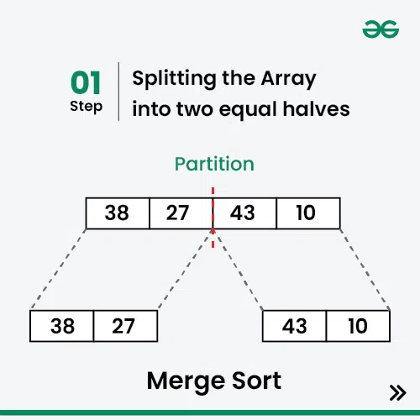
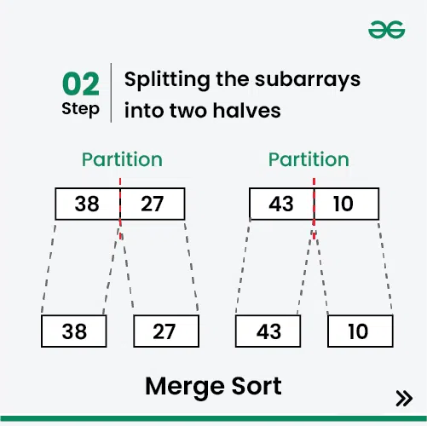
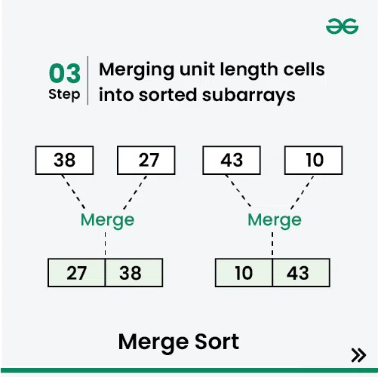
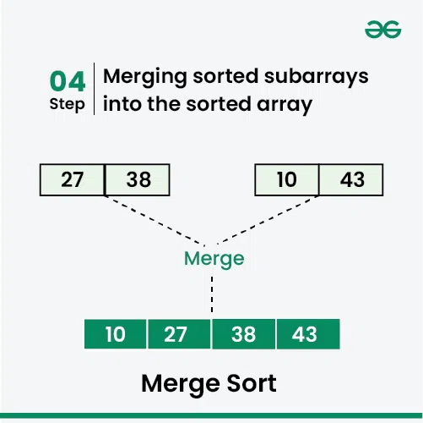
Recursive Tree Method

Slide 77
Calculate time complexity of { T(n) = 2T (n/2) + cn } by Recursive Tree method
16
n
16
8
8
8
n/2
n/2
Cn
4
4
4
4
n/4
Cn
4
n/4
n/4
n/4
2
Cn
2
n/8
n/8
n/8
n/8
Cn + Cn + Cn = 3Cn
log₂¹⁶ = logn
3Cn * logn
O(n*logn) → O(nlogn)
1
1

Slide 78
Calculate time complexity of { T(n) = 3T (n/4) + cn² } by Recursive Tree method
n
For 1st Division and merge n² power
For 2nd Division and merge (n/4)² → n²/16 but we need to do it for three times so power will be (3/16)n² d
For 3rd division and merge we need (9/16)n² power and we can also write it as (3/16)² n²
n/4
n/4
n/4
Cn²
3
16
n/16
n/16
n/16
n²
9
16
(3)²
16
n/64
n/64
n/64
n²
n²
27
16
(3)³
16
n/256
n/256
n/256
n²
n²

Slide 79
Calculate time complexity of { T(n) = 3T (n/4) + cn² } by Recursive Tree method
Cn² + 3/16 cn² + (3/16)² cn² + (3/16)³ cn² …… 1
Cn² [1 + 3/16 + (3/16)² + (3/16)³ + ….. 1 ]
if r < 1
formula : 1 / 1 - r
1 + r + r² + r³ + ……. 1
Cn² [ 1 / 1 - 3/16 ]
Cn² [1 / 13/16]
Cn² [ 16/13 ]
16/13 → Constant (ignore)
Time Complexity → O(n²)

Slide 80
Bubble Sort
Bubble Sort is the simplest sorting algorithm that works by repeatedly swapping the adjacent elements if they are in the wrong order.
Note : This algorithm is not suitable for large data sets as its average and worst-case time complexity is quite high.
In Bubble Sort algorithm,
Traverse from left and compare adjacent elements and the higher one is placed at right side.
In this way, the largest element is moved to the rightmost end at first.
This process is then continued to find the second largest and place it and so on until the data is sorted.

Slide 81
Time Complexity Analysis of Bubble Sort:
Best Case Time Complexity Analysis of Bubble Sort: O(N)
The best case occurs when the array is already sorted. So the number of comparisons required is N-1 and the number of swaps required = 0. Hence the best case complexity is O(N).
Worst Case Time Complexity Analysis of Bubble Sort: O(N²)
The worst-case condition for bubble sort occurs when elements of the array are arranged in decreasing order. In the worst case, the total number of iterations or passes required to sort a given array is (N-1). where ‘N’ is the number of elements present in the array.

Slide 82
Advantages and Disadvantages of bubble sort
Advantages of Bubble Sort:
Bubble sort is easy to understand and implement.
It does not require any additional memory space.
It is a stable sorting algorithm, meaning that elements with the same key value maintain their relative order in the sorted output.
Disadvantages of Bubble Sort:
Bubble sort has a time complexity of O(N²) which makes it very slow for large data sets.
Bubble sort is a comparison-based sorting algorithm, which means that it requires a comparison operator to determine the relative order of elements in the input data set. It can limit the efficiency of the algorithm in certain cases.

Slide 83
Bubble Sort
def sort(nums):
for I in range (len(nums)-1, 0, -1):
for j in range(i):
if nums[j] > nums[j+1]:
temp = nums[j]
nums[j] = nums[j+1]
nums[j+1] = temp
# Example usage:
nums = [5, 2, 8, 3, 1, 6, 4]
sort(nums)
print(nums) # [1, 2, 3, 4, 5, 6, 8]

Slide 84
Bubble Sort (using recursion)
def bubble_sort(arr, n=None):
if n is None:
n = len(arr) - 1
if n == 0:
return arr
for i in range(n):
if arr[i] > arr[i + 1]:
arr[i], arr[i + 1] = arr[i + 1], arr[i]
return bubble_sort(arr, n - 1)
# Example usage:
arr = [5, 2, 8, 3, 1, 6, 4]
arr = bubble_sort(arr)
print(arr) # [1, 2, 3, 4, 5, 6, 8]

Slide 85
Selection Sort
Selection sort is a simple and efficient sorting algorithm that works by repeatedly selecting the smallest (or largest) element from the unsorted portion of the list and moving it to the sorted portion of the list.
How does Selection Sort Algorithm work?
Lets consider the following array as an example: arr[] = {64, 25, 12, 22, 11}
First pass:
For the first position in the sorted array, the whole array is traversed from index 0 to 4 sequentially. The first position where 64 is stored presently, after traversing whole array it is clear that 11 is the lowest value.
Thus, replace 64 with 11. After one iteration 11,

Slide 86
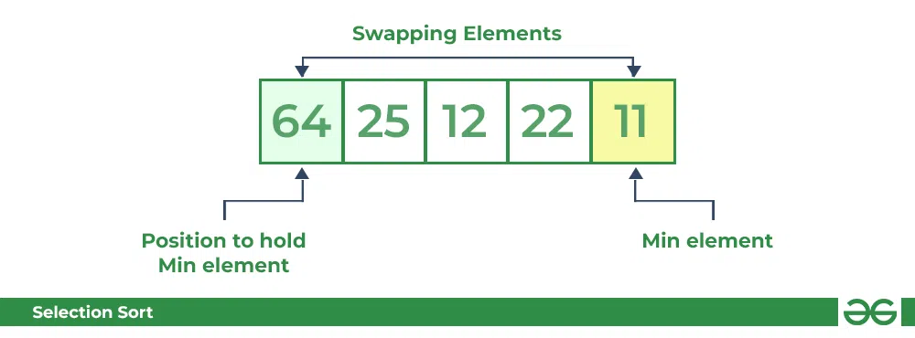
How does Selection Sort Algorithm work?
Lets consider the following array as an example: arr[] = {64, 25, 12, 22, 11}
First pass:
For the first position in the sorted array, the whole array is traversed from index 0 to 4 sequentially. The first position where 64 is stored presently, after traversing whole array it is clear that 11 is the lowest value.
Thus, replace 64 with 11. After one iteration 11, which happens to be the least value in the array, tends to appear in the first position of the sorted list.

Slide 87
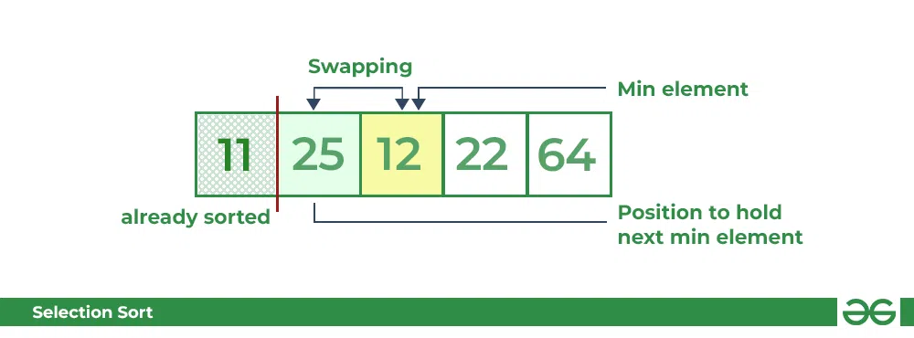
Second Pass:
For the second position, where 25 is present, again traverse the rest of the array in a sequential manner.
After traversing, we found that 12 is the second lowest value in the array and it should appear at the second place in the array, thus swap these values.

Slide 88
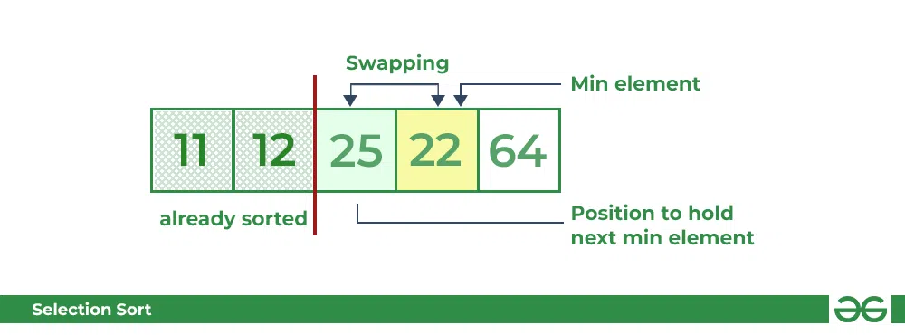
Third Pass:
Now, for third place, where 25 is present again traverse the rest of the array and find the third least value present in the array.
While traversing, 22 came out to be the third least value and it should appear at the third place in the array, thus swap 22 with element present at third position.

Slide 89
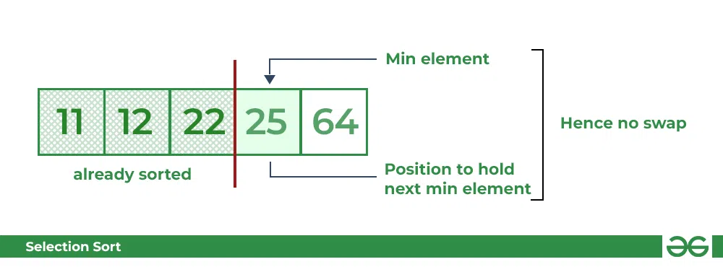
Fourth pass:
Similarly, for fourth position traverse the rest of the array and find the fourth least element in the array
As 25 is the 4th lowest value hence, it will place at the fourth position.

Slide 90
Complexity Analysis of Selection Sort
Time Complexity:
The time complexity of Selection Sort is O(N²) as there are two nested loops:
One loop to select an element of Array one by one = O(N)
Another loop to compare that element with every other Array element = O(N)
Therefore overall complexity = O(N) * O(N) = O(N*N) = O(N²)
Auxiliary Space:
O(1) as the only extra memory used is for temporary variables while swapping two values in Array. The selection sort never makes more than O(N) swaps and can be useful when memory writing is costly.

Slide 91
Advantages and Disadvantages of Selection sort
Advantages of Selection Sort Algorithm
Simple and easy to understand.
Works well with small datasets.
Disadvantages of the Selection Sort Algorithm
Selection sort has a time complexity of O(n^2) in the worst and average case.
Does not work well on large datasets.
Does not preserve the relative order of items with equal keys which means it is not stable.

Slide 92
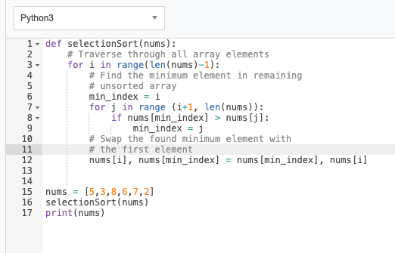
Selection Sort

Slide 93
Insertion Sort
Insertion sort is a simple sorting algorithm that works by iteratively inserting each element of an unsorted list into its correct position in a sorted portion of the list. It is a stable sorting algorithm, meaning that elements with equal values maintain their relative order in the sorted output.
Algorithm:
To achieve insertion sort, follow these steps:
We have to start with second element of the array as first element in the array is assumed to be sorted.
Compare second element with the first element and check if the second element is smaller then swap them.
Move to the third element and compare it with the second element, then the first element and swap as necessary to put it in the correct position among the first three elements.
Continue this process, comparing each element with the ones before it and swapping as needed to place it in the correct position among the sorted elements.
Repeat until the entire array is sorted.

Slide 94
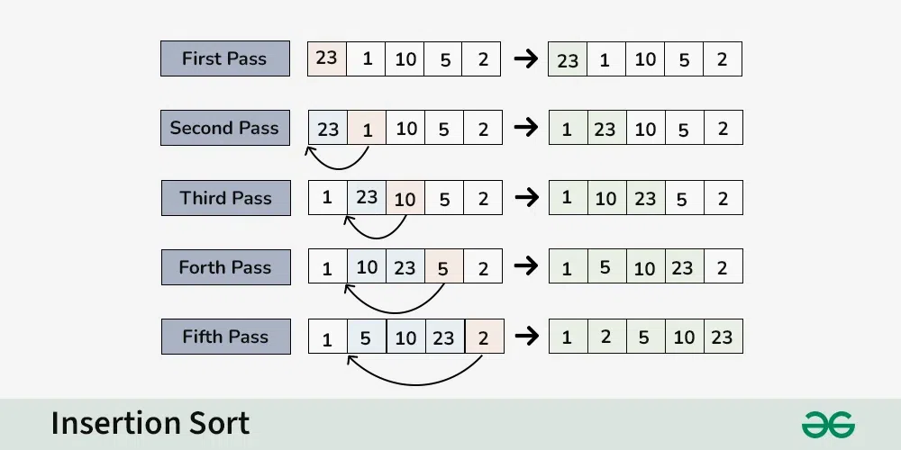
Working of Insertion Sort Algorithm:

Slide 95
First Pass:
Current element is 23
The first element in the array is assumed to be sorted.
The sorted part until 0th index is : [23]
Second Pass:
Compare 1 with 23 (current element with the sorted part).
Since 1 is smaller, insert 1 before 23.
The sorted part until 1st index is: [1, 23]
Third Pass:
Compare 10 with 1 and 23 (current element with the sorted part).
Since 10 is greater than 1 and smaller than 23, insert 10 between 1 and 23.
The sorted part until 2nd index is: [1, 10, 23]

Slide 96
Fourth Pass:
Compare 5 with 1, 10, and 23 (current element with the sorted part).
Since 5 is greater than 1 and smaller than 10, insert 5 between 1 and 10.
The sorted part until 3rd index is: [1, 5, 10, 23]
Fifth Pass:
Compare 2 with 1, 5, 10, and 23 (current element with the sorted part).
Since 2 is greater than 1 and smaller than 5 insert 2 between 1 and 5.
The sorted part until 4th index is: [1, 2, 5, 10, 23]
Final Array:
The sorted array is: [1, 2, 5, 10, 23]

Slide 97
Complexity Analysis of Insertion Sort
Time Complexity of Insertion Sort
Best case: O(n), If the list is already sorted, where n is the number of elements in the list.
Average case: O(n²), If the list is randomly ordered
Worst case: O(n²), If the list is in reverse order
Space Complexity of Insertion Sort
Auxiliary Space: O(1), Insertion sort requires O(1) additional space, making it a space-efficient sorting algorithm.

Slide 98
Advantages and Disadvantages of Insertion sort
Advantages of Insertion Sort:
Simple and easy to implement.
Stable sorting algorithm.
Efficient for small lists and nearly sorted lists.
Space-efficient.
Disadvantages of Insertion Sort:
Inefficient for large lists.
Not as efficient as other sorting algorithms (e.g., merge sort, quick sort) for most cases

Slide 99
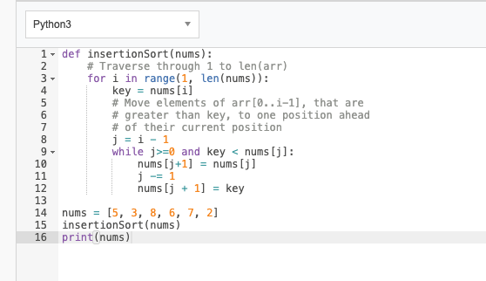
Insertion Sort

Slide 100
Unit 1 Complete

